Slide 1
Core Java
Multithreading, Vectors, Enumeration, Exception Handling

Slide 2
Multithreading
Thread – a program that has a single flow of control (one task)
Multithreading – sub-parts of a program implemented in parallel
Creating a thread – Thread class and Runnable interface
Thread class and Runnable Interface in java.lang package
main thread
Thread A
Thread B
Thread C

Slide 3
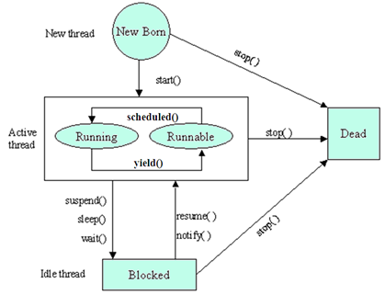
Multithreading
LIFE CYCLE

Slide 4
Multithreading
CREATING THREADS USING THREAD CLASS
class A extends Thread
{ public void run( )
{ for(int i = 1; i <= 5; i++)
{ System.out.println("Thread A with i = “ +i); }
System.out.println("Exit from Thread A ...");
}
}
class C extends Thread
{ public void run( )
{ for(int k = 1; k <= 5; k++)
{ System.out.println("Thread C with k = “ +k); }
System.out.println("Exit from Thread C …");
}
}
class B extends Thread
{ public void run( )
{ for(int j = 1; j <= 5; j++)
{ System.out.println("Thread B with j = “ +j); }
System.out.println("Exit from Thread B …");
}
}
public class Demo
{ public static void main(String args[])
{ A a = new A();
B b = new B();
C c = new C();
a.start();
b.start();
c.start(); } }

Slide 5

Multithreading
CREATING THREADS USING RUNNABLE INTERFACE
class C implements Runnable
{ public void run( )
{ for(int k = 1; k <= 5; k++)
{ System.out.println("Thread C with k = “ +k); }
System.out.println("Exit from Thread C …");
}
}
class A implements Runnable
{ public void run( )
{ for(int i = 1; i <= 5; i++)
{ System.out.println("Thread A with i = “ +i); }
System.out.println("Exit from Thread A ...");
}
}
public class Demo
{ public static void main(String args[])
{ A a = new A();
Thread t1 = new Thread(a);
B b = new B();
Thread t2 = new Thread(b);
C c = new C();
Thread t3 = new Thread(c);
t1.start(); t2.start(); t3.start();
} }
class B implements Runnable
{ public void run( )
{ for(int j = 1; j <= 5; j++)
{ System.out.println("Thread B with j = “ +j); }
System.out.println("Exit from Thread B …");
}
}

Slide 6
Multithreading
THREAD PRIORITIES
Priority of a thread tells how early it gets execution and is selected by the thread scheduler.
In Java, when we create a thread, always a priority is assigned to it. In a Multithreading environment, the processor assigns a priority to a thread scheduler. The priority is given by the JVM or by the programmer itself explicitly. The range of the priority is between 1 to 10.
There are three constant variables which are static and used to fetch priority of a Thread.
They are:-
1. public static int MIN_PRIORITY
It holds the minimum priority that can be given to a thread. The value for this is 1.
2. public static int NORM_PRIORITY
It is the default priority that is given to a thread if it is not defined. The value for this is 5.
3. public static int MAX_PRIORITY
It is the maximum priority that can be given to a thread. The value for this is 10.

Slide 7
Multithreading
Get and Set methods in Thread priority
1. public final int getPriority()
getPriority() method is in java.lang.Thread package. it is used to get the priority of a thread.
2. public final void setPriority(int newPriority)
setPriority(int newPriority) method is in java.lang.Thread package. It is used to set the priority of a thread.
setPriority(int priority)
1
5
10
Thread.MIN_PRIORITY
Thread.NORM_PRIORITY
Thread.MAX_PRIORITY

Slide 8
Multithreading
CREATING THREADS WITH PRIORITY
class C extends Thread
{ public void run( )
{ for(int k = 1; k <= 5; k++)
{ System.out.println("Thread C with k = “ +k); }
System.out.println("Exit from Thread C …");
}
}
class A extends Thread
{ public void run( )
{ for(int i = 1; i <= 5; i++)
{ System.out.println("Thread A with i = “ +i); }
System.out.println("Exit from Thread A ...");
}
}
public class Demo
{ public static void main(String args[])
{ A t1 = new A();
B t2 = new B();
C t3 = new C();
t3.setPriority(Thread.MAX_PRIORITY);
t2.setPriority(t3.getPriority() - 1);
t1.setPriority(Thread.MIN_PRIORITY);
t1.start(); t2.start(); t3.start();
} }
class B extends Thread
{ public void run( )
{ for(int j = 1; j <= 5; j++)
{ System.out.println("Thread B with j = “ +j); }
System.out.println("Exit from Thread B …");
}
}

Slide 9
Multithreading
Thread class (java.lang) – CONSTRUCTORS
public Thread()
Allocates a new Thread object.
Thread t = new Thread();
public Thread(Runnable r)
Allocates a new Thread object for a runnable type
A ob = new A(); //A is of type Runnable since class A implements Runnable
Thread t = new Thread(ob);
public Thread(String name)
Allocates a new Thread object with the given name
Thread t = new Thread(“SIES”);
public Thread(Runnable r, String name)
Allocates a new Thread object for r with the given name
A ob = new A(); //A is of type Runnable since class A implements Runnable
Thread t = new Thread(ob, “SIES”);
Sudha Bhagavatheeswaran, Department of Information Technology,
SIES College of Arts, Science & Commerce (Autonomous)

Slide 10
Multithreading
Thread class (java.lang) – METHODS
public final String getName() - Returns this thread's name.
String s= t.getName();
public final void setName(String name) - Changes the name of this thread to the given name
t.setName(“ABC”);
public final int getPriority() - Returns this thread's priority.
int i = t.getPriority();
public final void setPriority(int newPriority) - Changes the priority of this thread.
t.setPriority(Thread.MAX_PRIORITY);
public void start() - Causes this thread to begin execution; the Java Virtual Machine calls the run method of this thread.
t.start();
public void run() - This method has to be overridden by the class that extends Thread.
There is no statement for run() since run() is automatically called when start() is called
public static void sleep(long millis) throws InterruptedException - Causes the currently executing thread to sleep (temporarily cease execution) for the specified number of milliseconds.
Thread.sleep(3000);

Slide 11
Multithreading
Runnable interface(java.lang) – METHODS
void run()
This abstract method has to be overridden by the class that implements Runnable
There is no statement for run() since run() is automatically called when start() is called
Sudha Bhagavatheeswaran, Department of Information Technology,
SIES College of Arts, Science & Commerce (Autonomous)

Slide 12
VECTORS
ARRAYS
Datatype , Arrays class belongs to java.util package
Static; does not expand automatically
Contains variables of primitive data types
Zero based index
VECTORS
java.util package
Dynamic; expands automatically
Contains variables of primitive data types and objects
Zero based index

Slide 13
VECTORS
Creating a vector
Adding element to a vector
Accessing elements
Removing elements
Searching for elements
Retreiving/setting vector size

Slide 14
Creating a vector
VECTORS
public Vector()
Constructs an empty vector
Vector v = new Vector();
public Vector(Element e)
Constructs a vector containing the element (of any data type)
Vector v = new Vector(10);
Sudha Bhagavatheeswaran, Department of Information Technology,
SIES College of Arts, Science & Commerce (Autonomous)

Slide 15
Adding elements to a vector
VECTORS
public boolean add(E e)
Appends the specified element to the end of this Vector.
Vector v = new Vector();
v.add(“SIES”);
public void add(int index,E element)
Inserts the specified element at the specified position in this Vector. Shifts the
element currently at that position (if any) and any subsequent elements to the right
(adds one to their indices).
v.add(2,“SIES”);
Sudha Bhagavatheeswaran, Department of Information Technology,
SIES College of Arts, Science & Commerce (Autonomous)

Slide 16
Accessing elements in a vector
VECTORS
public E elementAt(int index)
Returns the component at the specified index.
E e = v.elementAt(3);
public E firstElement()
Returns the first component (the item at index 0) of this vector.
E e = v.firstElement();
public E lastElement()
Returns the last component of the vector.
E e =v.lastElement();
Sudha Bhagavatheeswaran, Department of Information Technology,
SIES College of Arts, Science & Commerce (Autonomous)

Slide 17
Removing elements in a vector
VECTORS
public void removeElementAt(int index)
Deletes the component at the specified index and shifts the other elements
accordingly.
v.removeElementAt(6);
public boolean removeElement(Object obj)
Removes the first (lowest-indexed) occurrence of the argument from this vector.
v.removeElement(45);
public void removeAllElements()
Removes all components from this vector and sets its size to zero.
v. removeAllElements();
Sudha Bhagavatheeswaran, Department of Information Technology,
SIES College of Arts, Science & Commerce (Autonomous)

Slide 18
Searching for an element in a vector
VECTORS
public boolean contains(Object o)
Returns true if this vector contains the specified element.
boolean b = v.contains(67);
Sudha Bhagavatheeswaran, Department of Information Technology,
SIES College of Arts, Science & Commerce (Autonomous)

Slide 19
Retreiving/setting vector size
VECTORS
public int size()
Returns the number of components in this vector.
int y = v.size();
public void setSize(int newSize)
Sets the size of this vector.
v.setSize(10);
Sudha Bhagavatheeswaran, Department of Information Technology,
SIES College of Arts, Science & Commerce (Autonomous)

Slide 20
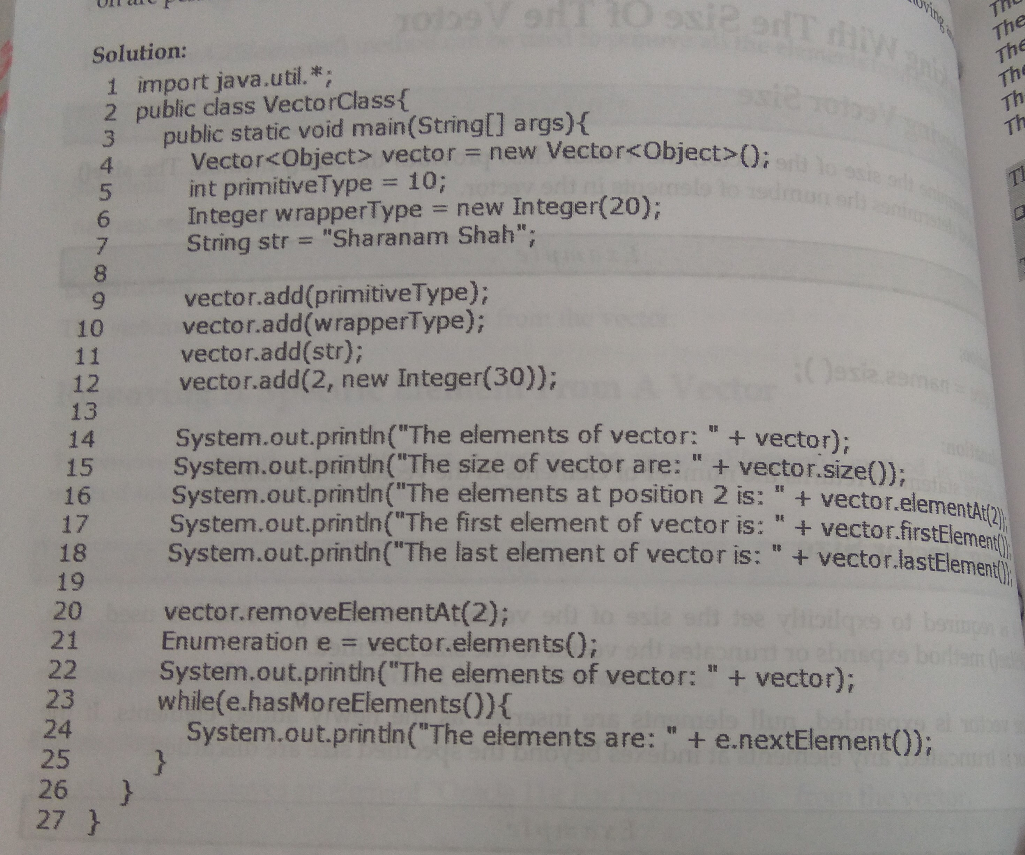
VECTORS
The elements of vector: [10,20,30, Sharanam Shah]
The size of the vector are: 4
The element at position 2 is : 30
The first element of the vector is : 10
The last element of the vector is : Sharanam Shah
The elements of the vector: [10,20,Sharanam Shah]
The elements are: 10
The elements are: 20
The elements are: Sharanam Shah

Slide 21
ENUMERATION - enums
Enumerations serve the purpose of representing a group of named constants in a programming language.
Enums are used when we know all possible values at compile time
public enum Suit
{ CLUB,DIAMOND,HEARTS,SPADE}
public enum Day
{ SUNDAY, MONDAY, TUESDAY, WEDNESDAY, THURSDAY, FRIDAY, SATURDAY }
public enum graduate
{YES,NO}
public enum graduate
{ MATHS, STATISTICS,CHEMISTRY, COMMERCE, IT, CS}

Slide 22
ENUMERATION - enums
package etest;
public enum Book
{ORACLE,JAVAEE,JSP}
package etest;
public class EnumTest
{ public static void main(String args[])
{ Book [ ] bk=Book.values();
for (Book b:bk)
{ System.out.println ( b.ordinal() +
“The royalty of book” +
b.toString() +
“is” +
BookRoyalty.calculateRoyalty(b));
} } }
package etest;
public class BookRoyalty
{ public static double calculateRoyalty(Book b)
{ double royalty=0.0;
if(b.equals(Book.ORACLE))
{royalty=50000;}
else if(b.equals(Book.JAVAEE))
{royalty=100000;}
else if(b.equals(Book.JSP))
{royalty=250000;}
return royalty;
}
}
OUTPUT:-
The royalty of book ORACLE is 50000
The royalty of book JAVAEE is 100000
The royalty of book JSP is 250000

Slide 23
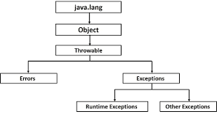
EXCEPTION HANDLING
Exceptions :- run time errors occurring in the program.
In java, Exception is an object
Exception object is an object that describes an exceptional condition that has occurred in a piece of code
try
catch
throw
throws
finally

Slide 24
Java Exception Keywords
EXCEPTION HANDLING
try | The "try" keyword is used to specify a block where we should place an exception code. It means we can't use try block alone. The try block must be followed by either catch or finally.
catch | The "catch" block is used to handle the exception. It must be preceded by try block which means we can't use catch block alone. It can be followed by finally block later.
finally | The "finally" block is used to execute the necessary code of the program. It is executed whether an exception is handled or not.
throw | The "throw" keyword is used to throw an exception.
throws | The "throws" keyword is used to declare exceptions. It specifies that there may occur an exception in the method. It doesn't throw an exception. It is always used with method signature.

Slide 25
EXCEPTION HANDLING
class A
{public static void main(String args[])
{ int d=0;
int a=42/d;
System.out.println(“d=“ +d);
}
}
class A
{public static void main(String args[])
{ int d,a;
try { d=0;
a=42/d;
System.out.println(“d=“+d);
} catch (ArithmeticException e)
{System.out.println(“Division by zero”);
}
System.out.println(“After catch statement”);
}
}
OUTPUT:-
Exception in thread "main" java.lang.ArithmeticException: / by zero
at A.main(A.java:4)
OUTPUT:-
Division by zero
After catch statement

Slide 26
EXCEPTION HANDLING
Displaying description of the exception (Throwable overrides toString() method of class Object)
class A
{public static void main(String args[])
{ int d,a;
try { d=0;
a=42/d;
System.out.println(“d=“+d);
} catch (Exception e)
{System.out.println(“error is ” +e);
}
System.out.println(“After catch statement”);
}
}
OUTPUT:-
error is java.lang.ArithmeticException: / by zero
After catch statement

Slide 27
EXCEPTION HANDLING
Multiple catch statements
class A
{public static void main(String args[])
{
try { int a=args.length;
System.out.println("a="+a);
int b=42/a;
int c[]={1};
c[20]=100;
} catch (ArithmeticException e)
{System.out.println("error is " + e);
}
catch (ArrayIndexOutOfBoundsException e)
{System.out.println("array out of range");
}
System.out.println("After catch statement");
}
}
OUTPUT:- (if args is zero)
D:\>java A
a=0
error is java.lang.ArithmeticException: / by zero
After catch statement
OUTPUT:- (if args is not zero)
D:\>java A 10 20 30
a=3
array out of range
After catch statement

Slide 28
EXCEPTION HANDLING
public class Test
{ static void validate(int age)
{ if (age<18)
throw new ArithmeticException(“not valid”);
else
System.out.println(“WELCOME TO VOTE”);
}
public static void main(String args[])
{ validate(10);
System.out.println(“VALIDATED”);
}
}
public class Test
{ static void validate(int age)
{ if (age<18)
throw new ArithmeticException(“not valid”);
else
System.out.println(“WELCOME TO VOTE”);
}
public static void main(String args[])
{ validate(30);
System.out.println(“VALIDATED”);
}
}
throw (statement)
throw Throwable instance;
1. Must be an object of Throwable or subclass of Throwable
2. Must not be primitive types, non-Throwable object
OUTPUT:-
WELCOME TO VOTE
VALIDATED
OUTPUT:-
Exception in thread "main" java.lang.ArithmeticException: not valid
at Test.validate(Test.java:4)
at Test.main(Test.java:9)

Slide 29
EXCEPTION HANDLING
throws (keyword)
1. Must be included in a method’s declaration
2. Must list the exceptions that a method might throw
class A {
void abc() throws ArithmeticException ,
ArrayIndexOutOfBoundsException
{ int a=0;
System.out.println("a="+a);
int b=42/a;
int c[]={1};
c[20]=100;
}
class A {
void abc() throws ArithmeticException ,
ArrayIndexOutOfBoundsException
{ int a=2;
System.out.println("a="+a);
int b=42/a;
int c[]={1};
c[20]=100;
}
}
class Test
{public static void main(String args[])
{
try { A ob=new A();
ob.abc();
} catch (ArithmeticException e)
{System.out.println(“Divide by zero”);
}
catch (ArrayIndexOutOfBoundsException e)
{System.out.println("array out of range");
}
System.out.println("After catch statement");
}
}
OUTPUT:-
D:\>java Test
a=0
Divide by zero
After catch statement
OUTPUT:-
D:\>java Test
a=2
array out of range
After catch statement

Slide 30
EXCEPTION HANDLING
USER DEFINED EXCEPTIONS
1. Create a subclass of Exception class
2. Two kinds of constructors may be used
For eg:- MyException()
OR
MyException(String str) { super(str); }
3. To raise the exception, we need to create an object of the user defined exception class and throw its object
public class Test
{ static void validate(int age) throws MyException
{ if (age<18)
throw new MyException(“not valid”);
else
System.out.println(“WELCOME TO VOTE”);
}
public static void main(String args[])
{ try { validate(40);
} catch(Exception e)
{ System.out.println(“error occurred”);
}
System.out.println(“After catch statement”);
}
public class Test
{ static void validate(int age) throws MyException
{ if (age<18)
throw new MyException(“not valid”);
else
System.out.println(“WELCOME TO VOTE”);
}
public static void main(String args[])
{ try { validate(10);
} catch(Exception e)
{ System.out.println(“error occurred”);
}
System.out.println(“After catch statement”);
}
class MyException extends Exception
{ MyException(String s)
{ super(s);
}
}
OUTPUT:-
D:\>java Test
WELCOME TO VOTE
After catch statement
OUTPUT:-
D:\>java Test
error occurred
After catch statement

